Slide 1

ENGINEERING CLINICS
FALL 2022-23

Slide 2
TEAM
GUIDE PROF.GANESH LAKSHMAN MOGANTI
R. RASAGNA 21MIC7025
S.AMRUTHA 21MIC7048
K.L.BHARADWAJ 21MIC7050
T.,SREE 21MIC7058
A.MADHU 21MIS7022
P.NIKHILESH 21MIS7087

Slide 3
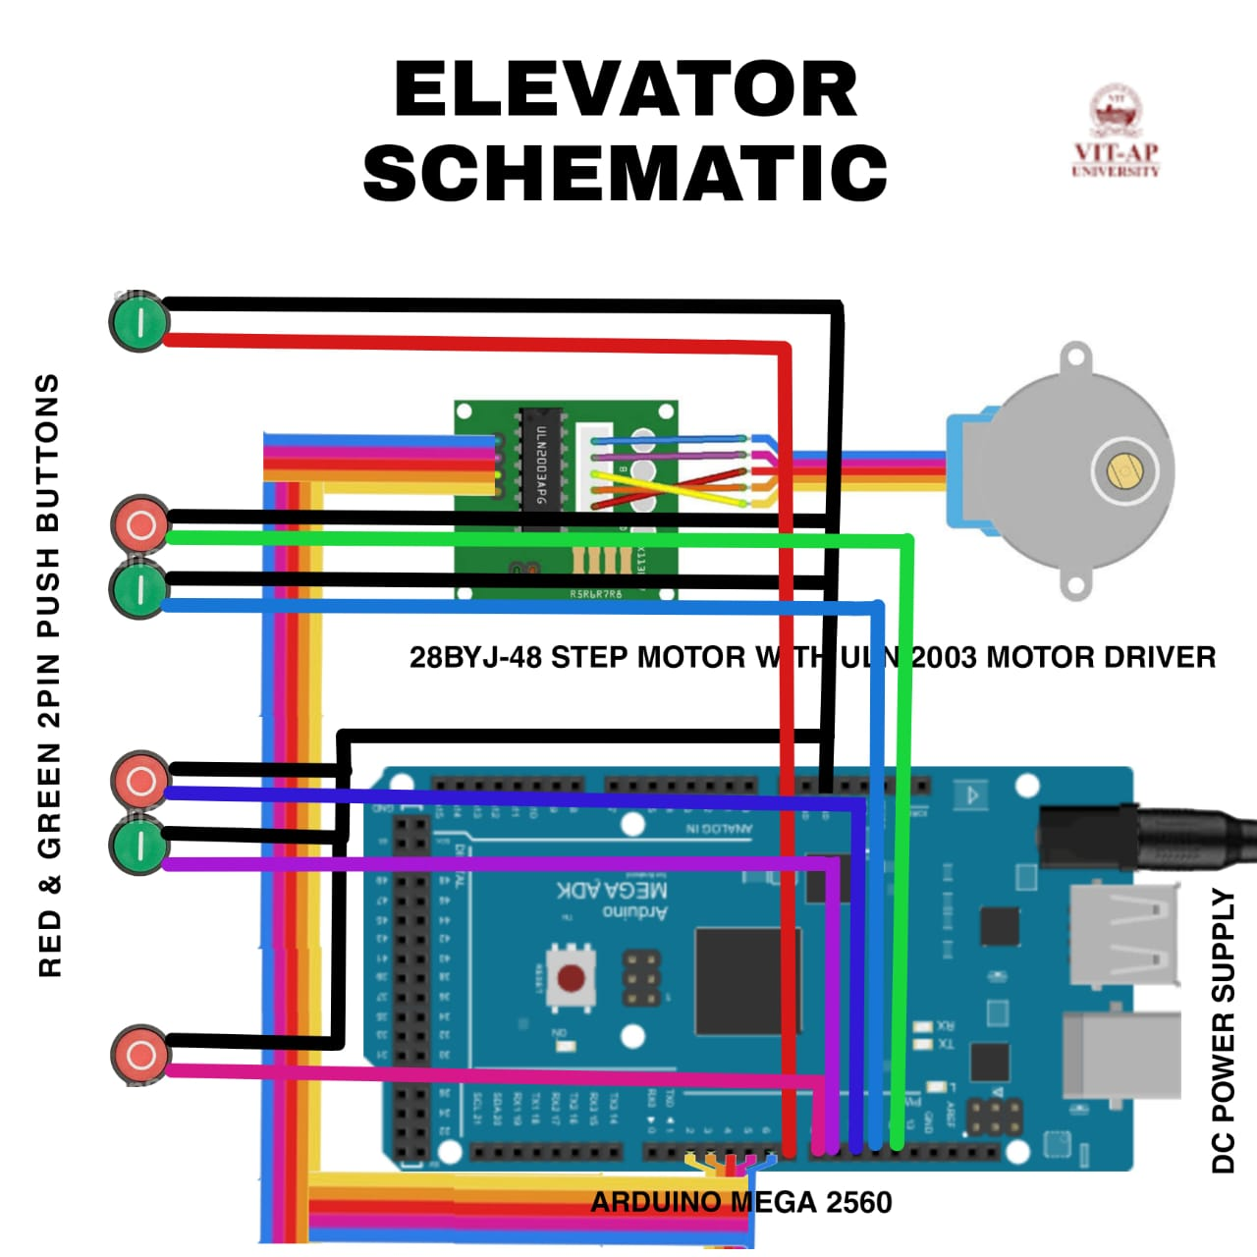
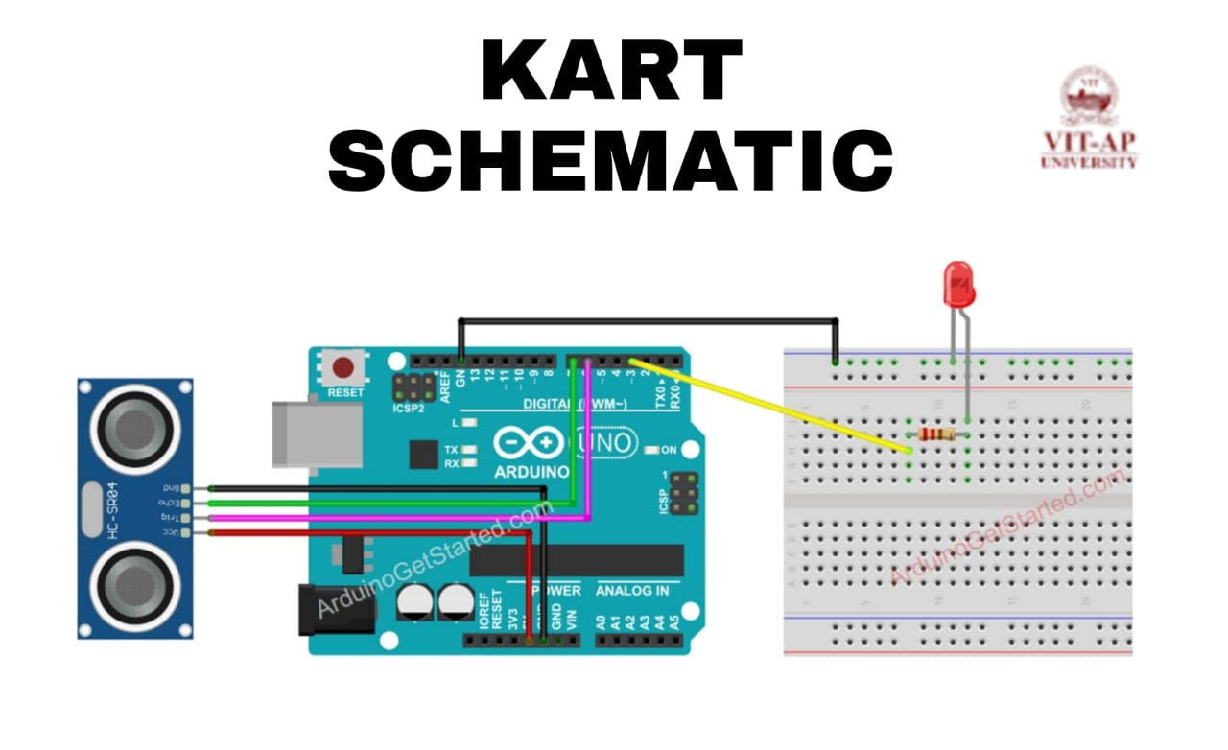
CIRCUIT

Slide 4
CODE :
const int CW =1;const int CCW =2;const int STOP =3;int Pin1 = 2;//IN1 is connected to 8 int Pin2 = 3;//IN2 is connected to 9 int Pin3 = 4;//IN3 is connected to 10 int Pin4 = 5;//IN4 is connected to 11int switchSTOP =2;//define input pin for STOP push buttonint stopType=1;//1=normal stop, 2=hold stop (consumes power)int speedFactor =1;//1=fastest, 2=slower or 3 more slowerlong angles[] = {2880,2880,2250,2430,2880,1400};//angles of each push buttonint pushButtons[] ={6,7,8,9,10,11};//digial pin for each push buttonint directions[] ={CCW,CW,CCW,CW,CCW,CW};//direction of eacch push buttonint speedFactors[] = {1,1,1,1,1,1};//speed for each push buttonint correction_CW = 150;int correction_CCW = 150;int poleStep = 0; long stepVale =0;const int SPR=64*64;long goToAngle=0;int activeButton=0;int pole1[] ={0,0,0,0, 0,1,1,1, 0};//pole1, 8 step valuesint pole2[] ={0,0,0,1, 1,1,0,0, 0};//pole2, 8 step valuesint pole3[] ={0,1,1,1, 0,0,0,0, 0};//pole3, 8 step valuesint pole4[] ={1,1,0,0, 0,0,0,1, 0};//pole4, 8 step valuesint count=0;int dirStatus = STOP;// stores direction status 3= stop (do not change)void setup() { Serial.begin(9600); Serial.begin("elevator using arduino"); pinMode(Pin1, OUTPUT);//define pin for ULN2003 in1 pinMode(Pin2, OUTPUT);//define pin for ULN2003 in2 pinMode(Pin3, OUTPUT);//define pin for ULN2003 in3 pinMode(Pin4, OUTPUT);//define pin for ULN2003 in4 pinMode(switchSTOP,INPUT_PULLUP); attachInterrupt(digitalPinToInterrupt(switchSTOP), stopMotor, FALLING ); for (byte i = 0; i < (sizeof(pushButtons) / sizeof(pushButtons[0])); i++) { pinMode(i,INPUT_PULLUP); } } //setup void loop() { stepVale = (SPR * goToAngle)/360 ; for (byte i = 0; i < (sizeof(angles) / sizeof(angles[0])); i++) { if(digitalRead(pushButtons[i]) == LOW) { goToAngle =angles[i]; dirStatus =directions[i]; count =0; activeButton =i; }// if ends }//for loop ends if(dirStatus ==CCW){ poleStep++; count++; if(count+correction_CCW <= stepVale) { driveStepper(poleStep); }else{ stopMotor(); } }else if(dirStatus ==CW){ poleStep--; count++; if(count+correction_CW <=stepVale) { driveStepper(poleStep); }else{ stopMotor(); } }else{ stopMotor(); } if(poleStep>7){ poleStep=0; } if(poleStep<0){ poleStep=7; } delay(speedFactors[activeButton]); }// loopvoid driveStepper(int c){ //Robojax.com Stepper Push button Any Angle STPB-5 digitalWrite(Pin1, pole1[c]); digitalWrite(Pin2, pole2[c]); digitalWrite(Pin3, pole3[c]); digitalWrite(Pin4, pole4[c]);}//driveStepper ends herevoid stopMotor(){ for (byte i = 0; i < (sizeof(angles) / sizeof(angles[0])); i++) { digitalWrite(pushButtons[i], HIGH); }//for loop ends dirStatus = STOP; if( stopType ==2) { driveStepper(8); }}//stopMotor()

Slide 5
ALGORITHM
HERE, THE PINS OF THE ULN2008 DRIVER ARE CONNECTED TO THE DIGITAL PINS AS FOLLWED INT 1-DIGITAL PIN 2 INT 2-DIGITAL PIN 3 INT3-DIGITAL PIN 4 INT4-DIGITAL PIN 5 INT5-DIGITAL PIN 6 HERE, THE PINS OF THE BUTTONS ARE CONNECTED TO THE DIGITAL PINS&GND AS FOLLWED BTN 1-DIGITAL PIN 6(GROUND FLOOR) BTN 2-DIGITAL PIN 7(3rd FLOOR-UP) BTN3-DIGITAL PIN 8(1st FLOOR-UP) BTN4-DIGITAL PIN 9(1st FLOOR-DOWN) BTN5-DIGITAL PIN 10(2nd FLOOR-UP) BTN6-DIGITAL PIN11(2nd FLOOR-DOWN) FOR EACH BUTTON THERE ARE 2 PINS IN WHICH ONE PIN IS CONECTED TO GND AND ANOTHER TO THE DIGITAL PINHERE THE ANGLES OF THE PUSH BUTTON ARE {2880,2880,2250,2430,2880,1400}HERE THE DIRECTION OF THE EACH PUSH BUTTON IS {CCW,CW,CCW,CW,CCW,CW}

Slide 6
THANK YOU

